Slide 1

GE100 - Application of Information and Communication Technologies
Lec # 4: System Unit-Processing and Memory
Instructor: Alina Maryum

Slide 2
Learning Objectives
Understand how data and programs are represented to a computer and be able to identify a few of the coding systems used to accomplish this
Explain the functions of the hardware components commonly found inside the system unit, such as the CPU, GPU, memory, buses, and expansion cards
Describe how peripheral devices or other hardware can be added to a computer
Understand how a computer’s CPU and memory components process program instructions and data
Name and evaluate several strategies that can be used today to speed up the operations of a computer
List some processing technologies that may be used in future computers

Slide 3
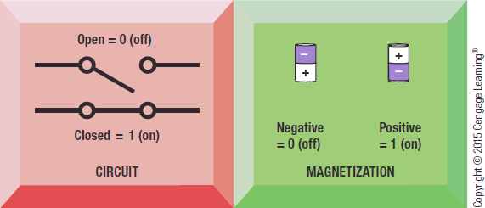
Data and Program Representation
Digital Data Representation
Coding Systems
Used to represent data and programs in a manner understood by computer
Digital Computers
Can only understand two states, off and on (0 and 1)
Digital Data Representation
The process of representing data in digital form so it can be understood by a computer

Slide 4
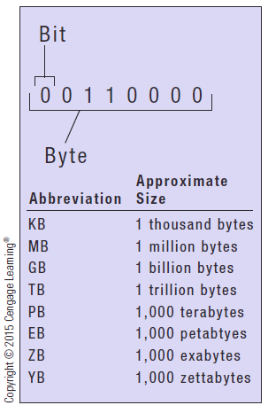
Data and Program Representation
Bit
The smallest unit of data that a computer can recognize
Byte = 8 bits
Eight bits grouped together are collectively referred to as a byte
Document size, storage capacity, and memory capacity are all measured in bytes
Prefixes are often used to express larger quantities of bytes: kilobyte (KB), megabyte (MB), gigabyte (GB), terabyte (TB), petabyte (PB), exabyte (EB), zettabyte (ZB), yottabyte (YB)

Slide 5
Representing Numerical Data
Numbering System
A way of representing numbers
Decimal numbering system
Uses 10 symbols (0-9)
Binary numbering system
Uses only two symbols (1 and 0) to represent all possible numbers
In both systems, the position of the digits determines power or exponent to which base number is raised
10 for decimal
2 for binary

Slide 6
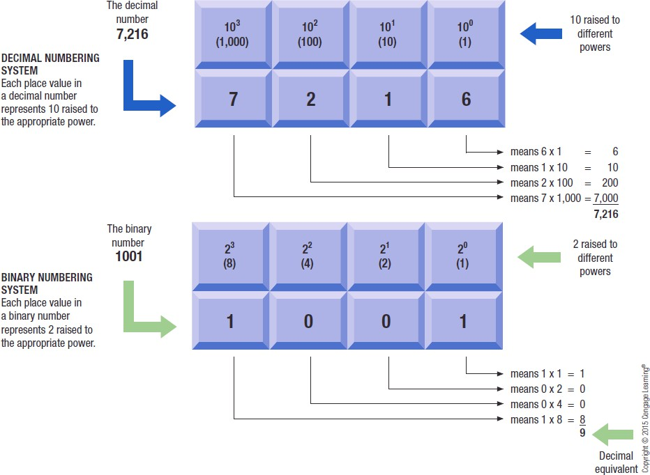
Representing Numerical Data

Slide 7
Coding Systems for Text-Based Data
Text-based data is represented by binary coding systems specifically developed for text-based data
ASCII
EBCDIC
Unicode
These codes represent all characters that can appear in text data
Numbers
Letters
Special characters and symbols like the dollar sign, comma, percent symbol, and mathematical symbols

Slide 8
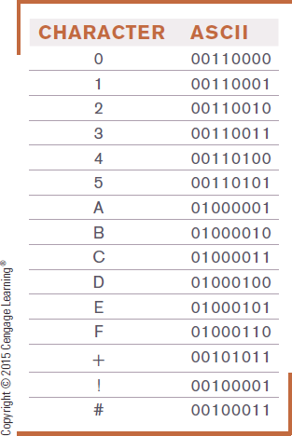
Coding Systems for Text-Based Data
ASCII (American Standard Code for Information Interchange)
Coding system traditionally used with personal computers
7-digit (7-bit) code
Several different 8-bit extended versions of ASCII
EBCDIC (Extended Binary-Coded Decimal Interchange Code)
Developed by IBM, primarily for mainframes
Unique combination of 8 bits (1 byte), which allows 256 (28) unique combinations

Slide 9
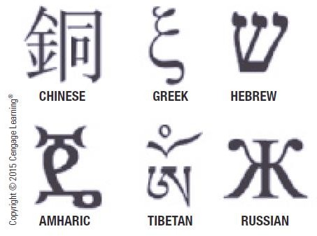
Coding Systems for Text-Based Data
Unicode
Universal coding standard designed to represent text-based data
written in any ancient or modern language
Longer code, consisting of 8 to 32 bits per character, and can represent over one million characters
Replacing ASCII as the primary text-coding system
Includes ASCII character set so ASCII data can be converted easily to Unicode when needed
Used by most Web browsers, pages, and applications
Latest versions of Microsoft Windows, Office, OS X
Modern programming languages, such as Java and Python
Updated regularly to add new characters

Slide 10
Coding Systems for Other Types of Data
Graphics Data (still images such as photos or drawings)
Bitmapped images
Image made of up of a grid of small dots called pixels
Monochrome graphic can only be one of two colors
Requires just one bit for color storage
Images with more than two colors
Can use 4, 8, or 24 bits to store the color data for each pixel
More bits = more colors

Slide 11
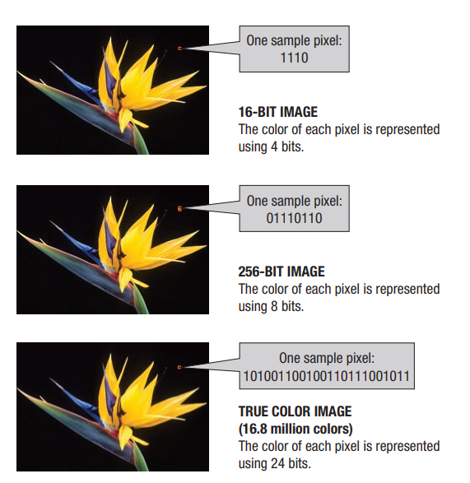
Coding Systems for Other Types of Data

Slide 12
Coding Systems for Other Types of Data
Audio Data
Must be in digital form in order to be stored on or processed by computer
Often compressed when sent over the Internet
MP3 files are 10 times smaller than their uncompressed digital versions
Download more quickly and take up less storage space
Video Data
Displayed using a collection of frames, each frame contains a still image
Amount of data can be substantial but can be compressed

Slide 13
Representing Software Programs
Machine language
Binary-based programming language, consisting only of 0s and 1s, that a computer can execute directly
Early programs were written in machine language
Today’s programs still need to be translated into machine language in order to be understood by the computer

Slide 14
Inside the System Unit
System Unit
The main case of a computer or mobile device
Houses the processing hardware for a computer as well as other components, such as storage devices, the power supply, and cooling hardware
With a desktop computer, usually looks like a rectangular box
Contains one or more processors, several types of memory, interfaces to connect external peripheral devices (such as printers), and other components all interconnected through sets of wires called buses on the motherboard

Slide 15
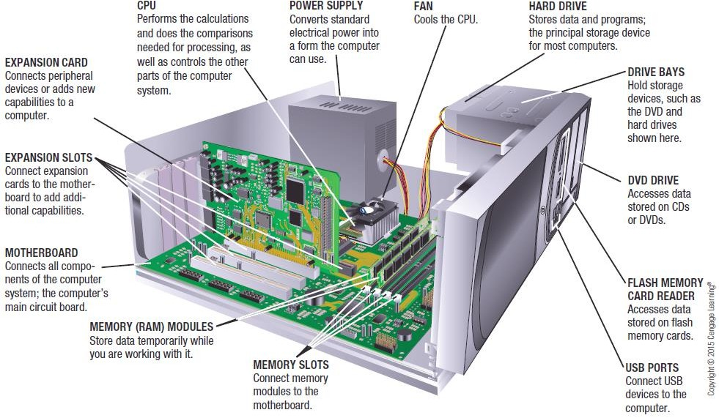
Inside the System Unit

Slide 16
Inside the System Unit
1. Motherboard
Main circuit board of a computing device
Located inside the system unit, to which all computer system components connect
– Computer Chip (called integrated circuits (ICs))
• Contain interconnected components (such as transistors) that enable electrical current to perform particular functions
– Circuit Board
Thin board containing computer chips and other electronic components

Slide 17
Inside the System Unit
Motherboard has a variety of chips, boards, and connectors attached to it
All devices used with a computer need to be connected via a wired or wireless connection to motherboard
External devices (monitors, keyboards, mice, printers) plugging into a port— special connector exposed through the exterior of the system unit case
Wireless devices use either a transceiver that plugs into a port on the computer to transmit data between the wireless device and the motherboard or wireless networking technology such as Bluetooth, Wi-Fi

Slide 18
Inside the System Unit
2. Power Supply and Drive Bays
Power Supply
Most personal computers plug into a standard electrical outlet
Power supply inside a computer delivers electricity to the computer via a power cord
Portable computers and mobile devices contain rechargeable battery packs, which are charged via a power outlet
Drive Bay
Rectangular metal racks inside system unit into which storage devices can be inserted
Hard drive, DVD drive, flash memory card reader
Connected to the motherboard with a cable

Slide 19
Inside the System Unit
3. Processors
A chip (such as the CPU or GPU) that performs processing functions
Circuitry and components packaged together and connected directly to the motherboard
The CPU (Central Processing Unit)
The chip located on motherboard of a computer
Performs most of the processing for a computer
Also called Microprocessor for personal computer
Typically designed for a specific type of computer, such as for desktop computers, servers, portable computers (like notebook and tablet computers), or mobile devices (like tablets and smartphones)

Slide 20
Inside the System Unit
Typically different CPUs for desktop computers, portable computers, servers, mobile devices, consumer devices, etc.
Personal computer CPU often made by Intel or AMD
Media tablets and mobile phones use processors made by other companies such as ARM

Slide 21
Inside the System Unit
Dual-core CPU
Contains two separate processing cores
Quad-core CPU
Contains four separate processing cores
Multi-core CPU
Contain the processing components or cores of multiple independent processors on a single CPU
Allow computers to work on more than one task at a time
Typically experience fewer heat problems than single-core CPU
Each core typically runs slower than a single-core CPU, although total processing power of the multi-core CPU is greater
Increase performance of mobile devices while, at the same time, delivering better battery life

Slide 22
Inside the System Unit
Most support virtualization and other recent technologies
CPUs used in desktop computers typically have 4 cores
Server processors may have 15 cores or more
Mobile processors
Typically run a little slower than comparable desktop CPUs
But they are often multi-core and they run cooler
Consume less power to allow devices to run longer on battery power without a recharge

Slide 23
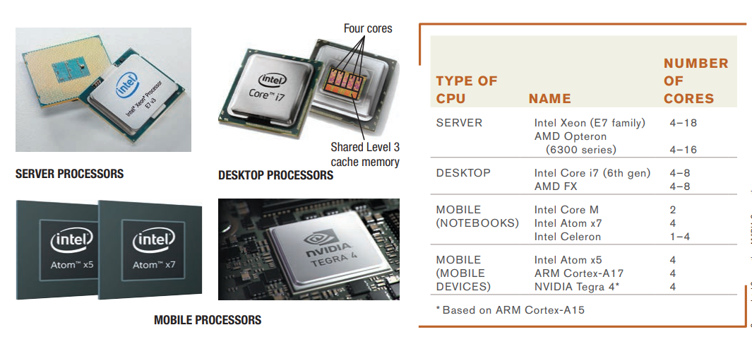
Inside the System Unit

Slide 24
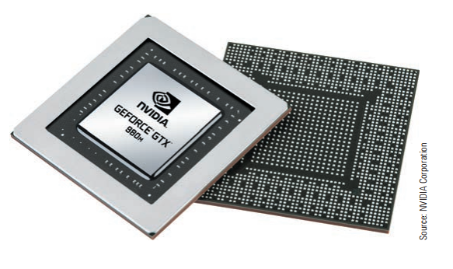
Inside the System Unit
4. GPU (Graphics Processing Unit)
Takes care of the processing needed to display images (including still images, and animations) on the screen
Can be located on motherboard, on video graphics board, or both CPU and GPU integrated into CPU package

Slide 25
Inside the System Unit
Processing Speed
CPU clock speed is one measurement of processing speed
Rated in megahertz (MHz) or gigahertz (GHz)
Higher CPU clock speed = more instructions processed per second
Alternate measure of processing speed is the number of instructions a CPU can process per second
Megaflops (millions), gigaflops (billions), teraflops (trillions)
Benchmark tests can be used to evaluate overall processing speed

Slide 26
Inside the System Unit
Word Size
The amount of data that a CPU can manipulate at one time
Typically 32-bit or 64-bit
Usually, a larger word size allows for faster processing and use of more RAM
Cache Memory
Special group of very fast memory chips located on or close to the CPU
Level 1 is fastest, then Level 2, then Level 3
More cache memory typically means faster processing
Usually internal cache (built into the CPU)

Slide 27
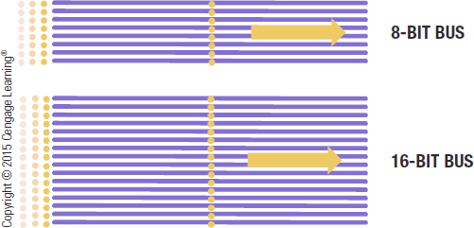
Inside the System Unit
Bus Width, Bus Speed, and Bandwidth
Bus is an electronic path over which data can travel
Found inside the CPU and on the motherboard
Bus width is the number of wires in the bus over which data can travel
A wider bus allows more data to be transferred at one time
Bus speed determines the bus’s bandwidth—that is, the amount of data that can be transferred via the bus in a given time period
Amount of data actually transferred under real-life conditions is called throughput

Slide 28
Inside the System Unit
5. Memory
Refers to chip-based storage located inside the system unit
Storage refers to the amount of long-term storage available to a computer
Random Access Memory (RAM)
Computer’s main memory
Consists of chips arranged on a circuit board called a memory module which are plugged into motherboard
Stores essential parts of operating system, programs, and data computer is currently using

Slide 29
Inside the System Unit
Volatile
RAM content lost when the computer is shut off
ROM and flash memory are non-volatile
Measured in bytes
Amount installed depends on the CPU and operating system being used
Like the CPU, RAM consists of electronic circuits etched onto chips
Smartphones and other mobile devices typically use embedded memory chips
Memory chips for servers and personal computers are typically arranged onto circuit boards called memory modules, which, in turn, are plugged into motherboard

Slide 30
Inside the System Unit
Most desktop and server memory modules are dual in-line memory modules DIMMs
Notebook computers are smaller small outline DIMMs or SO-DIMMs
Smaller devices even smaller are Mini-DIMMs or Micro-DIMMs
Most personal computers today use SDRAM (synchronous dynamic RAM)
SDRAM is available in several DDR (double-data rate) versions, including DDR2, DDR3, and DDR4.
To further improve memory performance, memory typically uses a dual-channel memory architecture, which has two paths that go to and from memory and so it can transfer twice as much data at one time as single-channel memory architecture of the same speed.
Notes:
It is called "dynamic" because it requires constant refreshing to maintain the data stored in its memory cells,
his synchronization improves its speed and performance by allowing it to send and receive data in sync with the CPU, reducing the time the processor spends waiting for memory operations.

Slide 31
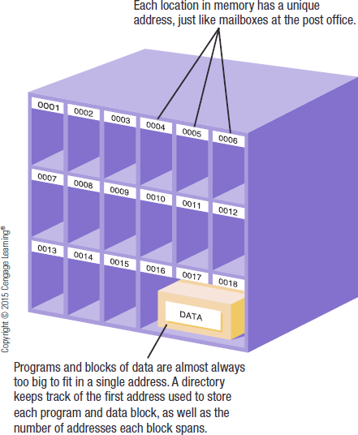
Inside the System Unit
Each location in memory has an address
Each location typically holds one byte
Whenever a block of data, instruction, program, or result of a calculation is stored in memory, it is usually stored in one or more consecutive addresses, depending on its size
Computer system sets up and maintains directory tables to facilitate retrieval of the data

Slide 32
Inside the System Unit
Registers
High-speed memory built into the CPU
Used to store data and intermediary results during processing
Fastest type of memory even faster than Level 1 cache
ROM (read-only memory)
Non-volatile chips located on the motherboard into which data or programs have been permanently stored
Retrieved by the computer when needed
Neither write over the data or programs in ROM chips
Used to store the permanent instructions referred to as firmware
Being replaced with flash memory

Slide 33
Inside the System Unit
Flash Memory
Nonvolatile memory chips that can be used for storage
Have begun to replace ROM for storing system information
Now stores firmware for personal computers and other devices
Built into many types of devices (media tablets, mobile phones, and digital cameras) for user storage

Slide 34
Inside the System Unit
6. Fans and Heat Sinks
Heat is an ongoing problem for CPU and computer manufacturers
Can damage components
Cooler chips run faster
Use fans and heat sinks (small components typically made out of aluminum with fins) that help to dissipate heat
Liquid cooling systems cool the computer with liquid-filled tubes
Immersion cooling hardware is actually submerged into units filled with liquid cooling solution
Notebook cooling stand cools the underside of a notebook computer
Other cooling methods, such as ion pump cooling systems, are under development

Slide 35
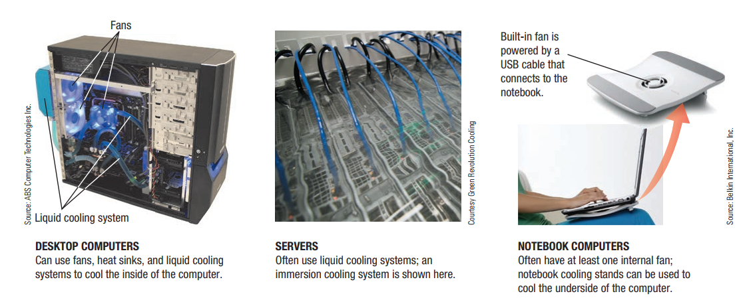
Fans, heat sinks, and Other Cooling Components

Slide 36
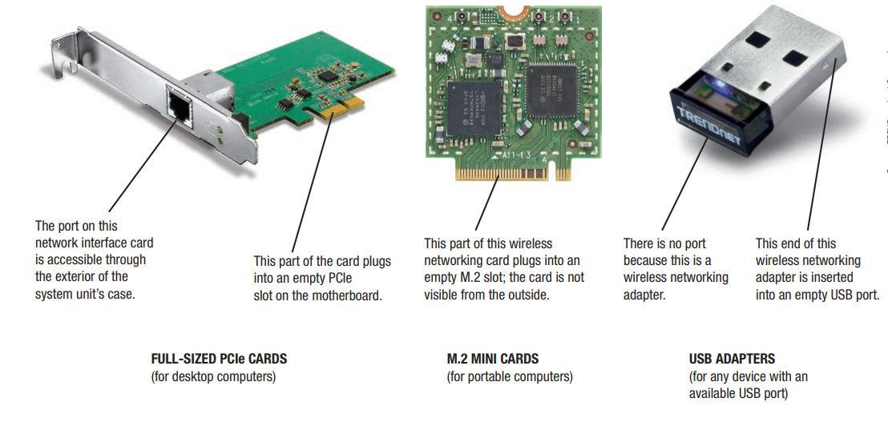
Inside the System Unit
7. Expansion Slot and Expansion Cards
Expansion Slot
A location on the motherboard into which expansion cards are inserted
Expansion Card
A circuit board inserted into an expansion slot
Used to add additional functionality or to attach a peripheral device
Notes:
GPU, NIC, Sound Card etc.

Slide 37
Inside the System Unit
8. Bus
Electronic path within a computer over which data travel. It is Located within the CPU and etched onto the motherboard
Expansion Bus- Connects the CPU to peripheral (typically input and output) devices
Memory Bus- Connects CPU directly to RAM
Frontside Bus (FSB)
Connects CPU to the chipset that connects the CPU to the rest of the bus architecture
Use special highspeed technologies. Intel uses its QuickPath Interconnect (QPI) technology and AMD uses its HyperTransport Technology

Slide 38
Inside the System Unit
PCI (Peripheral Component Interconnect) and PCI Express (PCIe) Bus
PCI has been one of the most common types
PCI Express (PCIe) bus (which connects to the PCI bus) is more often used for expansion
Available in several different widths
16-bit version of PCIe (referred to as PCIe x16) is commonly used with video graphics cards to connect a monitor to a desktop computer
Expansion cards for other peripherals often connect via the 1-bit PCIe bus (referred to as PCIe x1)
Extremely fast—the current version (PCIe 4.0) transfers data at 16 Gbps (billions of bits per second) per lane

Slide 39
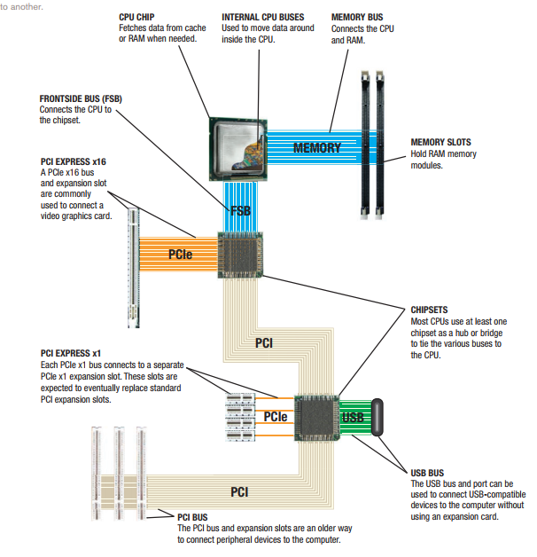
Buses

Slide 40
Inside the System Unit
Universal Serial Bus (USB)
Extremely versatile
Allows 127 different devices to connect to a computer via a single USB port
Original USB standards are relatively slow
USB 1.0 transfer data at 12 Mbps
USB 2.0 transfer data at 480 Mbps
Newest standards (also called SuperSpeed USB) are much faster
USB 3.0 transfer data at 5 Gbps
USB 3.1 transfer data at 10 Gbps
USB 3 also supports faster and more powerful charging
Identify USB 3 ports, they are coloured blue

Slide 41
Inside the System Unit
9. Port and Connectors
Connectors located on the exterior of a computer’s system unit that are used to connect external hardware devices
Each port is attached to the appropriate bus on the motherboard so that when device is plugged into a port, the device can communicate with CPU and other computer components
Ports often found on a desktop or notebook computer
USB, Audio, and HDMI, Network, Flash memory card slot, DisplayPort
Mobile devices often use smaller versions, such as micro-USB and micro-HDMI

Slide 42
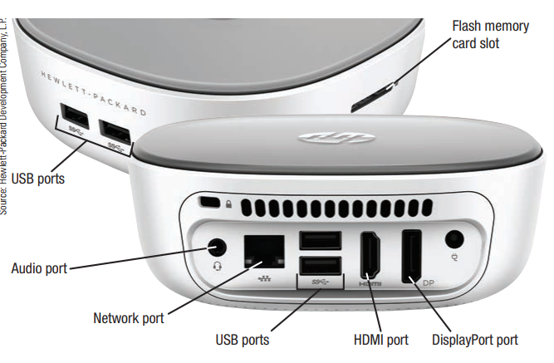
Ports and Connectors
Typical Ports

Slide 43
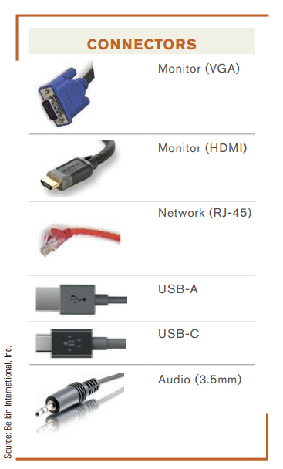
Ports and Connectors
Typical Connectors

Slide 44
Inside the System Unit
Various types of ports
Monitor ports
Used to connect a monitor to a computer via an HDMI (High-Definition Multimedia Interface)
Additional monitor to a tablet or other mobile device, a Mini-HDMI port or even smaller Micro-HDMI
Network ports
Used to connect a computer to a computer network via a networking cable—typically a cable using an RJ-45 connector
USB ports
Used to connect USB devices (such as keyboards, mice, printers, hard drives, and digital cameras)

Slide 45
Inside the System Unit
IrDA (Infrared Data Association) and Bluetooth ports
Used to receive wireless transmissions from devices
IrDA ports are commonly used to “beam” data from a portable computer or mobile device to a computer
Bluetooth ports are most often used with wireless keyboards, mice, speakers, and headsets
Flash memory card slots
Used to connect flash memory cards or other hardware using a flash memory card interface

Slide 46
Inside the System Unit
Audio ports
Used to connect speakers, headphones, or a microphone to the computer
eSATA (external SATA) ports
Used to connect external SATA devices (external hard drive)
External hard drives that connect via eSATA are much faster than external hard drives that connect via a USB
Thunderbolt ports
Available primarily on some Apple devices
Used to connect peripheral devices (such as storage devices and monitors) via Thunderbolt cables
Latest version of Thunderbolt, Thunderbolt 3, is extremely fast, 40 Gbps
Notes:
Serial Advanced Technology Attachment

Slide 47
Inside the System Unit
Most computers today support the Plug and Play standard
Computer automatically configures new devices as soon as they are installed and the computer is powered up
Tablets have ports similar to desktop and notebook computers, but they often have fewer of them
Smartphones tend to have a more limited amount of expandability
Have a USB port
Flash memory card slot
Subscriber Identify Module (SIM) slot to hold a SIM card used to connect that device to a mobile phone network

Slide 48
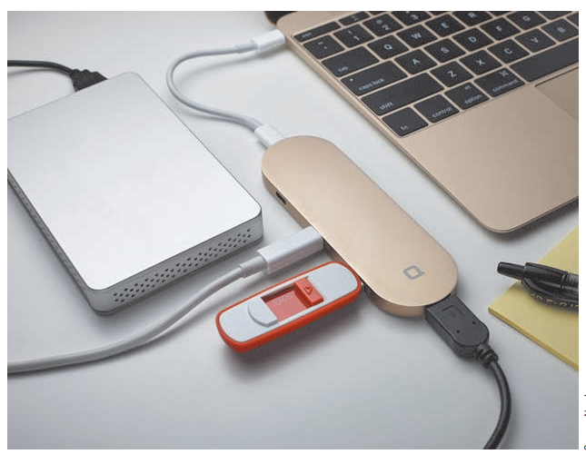
Inside the System Unit
USB hubs
This USB hub is used to connect multiple USB-A and USB-C devices to a
single USB-C port

Slide 49
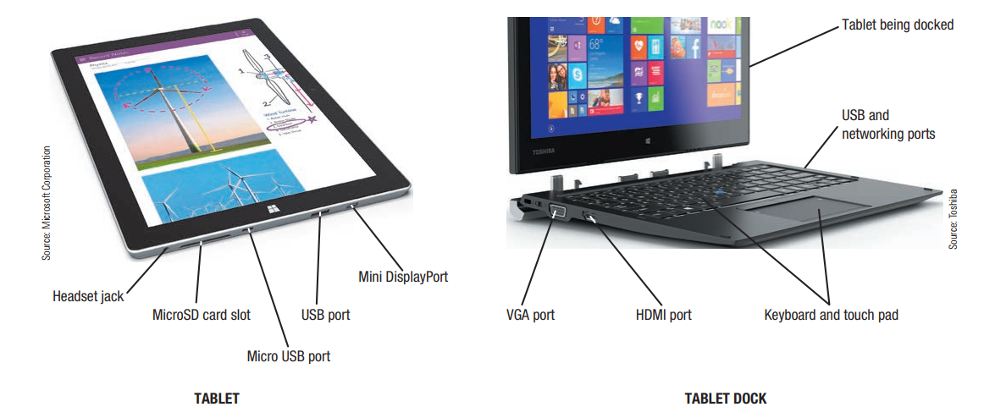
Inside the System Unit
Typical ports for tablets and tablet docks

Slide 50
How the CPU Works
CPU (Central Processing Unit)
Consists of a variety of circuitry and components packaged together
Transistor: Key element of the microprocessor
Made of semi-conductor material that acts like a switch controlling the flow of electrons inside a chip
Today’s CPUs contain hundreds of millions of transistors
Moore’s Law Number doubles about every 18 months
In 1965, Gordon Moore predicted that the number of transistors per square inch on chips had doubled every two years and that trend would continue
Moore’s Law is still relevant today for processors as well as other computer components

Slide 51
How the CPU Works
Typical CPU Components
Arithmetic/Logic Unit (ALU)
Performs arithmetic involving integers and logical operations
Floating Point Unit (FPU)
Performs decimal arithmetic
Control Unit (CU)
Coordinates and controls activities within a CPU core
Prefetch Unit (PU)
Attempts to retrieve data and instructions before they are needed for processing in order to avoid delays

Slide 52
How the CPU Works
Decode Unit
Translates instructions from the prefetch unit so they are understood by the control unit, ALU, and FPU
Registers and Internal Cache Memory
Store data and instructions needed by the CPU
Bus Interface Unit
Allows the core to communicate with other CPU components

Slide 53
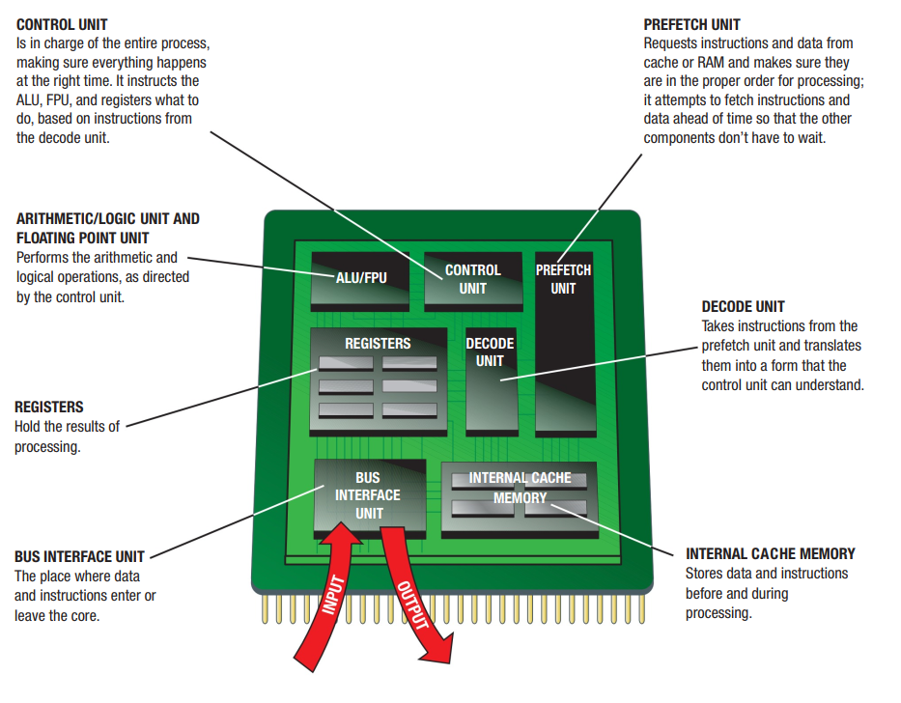
How the CPU Works

Slide 54
The System Clock and the Machine Cycle
System Clock
Small quartz crystal on the motherboard
Timing mechanism within the computer system that synchronizes computer’s operations
Sends out a signal on a regular basis to all computer components
Each signal is a cycle
Number of cycles per second is measured in hertz (Hz)
One megahertz = one million ticks of the system clock

Slide 55
The System Clock and the Machine Cycle
Many PC system clocks run at 200 MHz
CPU that is synchronized with system clock runs at either system clock speed or at a multiple of or a fraction of system clock speed
CPU clock speed of 2 GHz, uses a multiplier of 10, means CPU clock “ticks” 10 times during each system clock tick
During each CPU clock tick, one or more pieces of microcode are processed
CPU with a higher clock speed processes more instructions per second than same CPU with a lower CPU clock speed

Slide 56
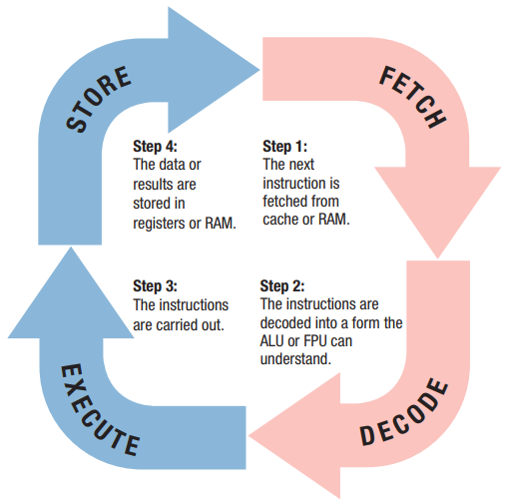
The System Clock and the Machine Cycle
Machine Cycle
– The series of operations involved in the execution of a single machine-level instruction
– Each machine cycle consists of four general operations
Fetch
Decode
Execute
Store

Slide 57
Making Computers Faster and Better Now and in the Future
Improving the Performance of Your System Today
Add more memory
Perform system maintenance
Uninstall programs properly
Remove unnecessary programs from the Startup list
Consider placing large files not needed on a regular basis on external storage
Delete temporary files

Slide 58
Making Computers Faster and Better Now and in the Future
Error check and defrag the hard drive periodically
Scan for viruses and spyware continually
Clean out dust once or twice a year
Buy a larger or second hard drive
Upgrade your Internet connection
Upgrade your video graphics card

Slide 59
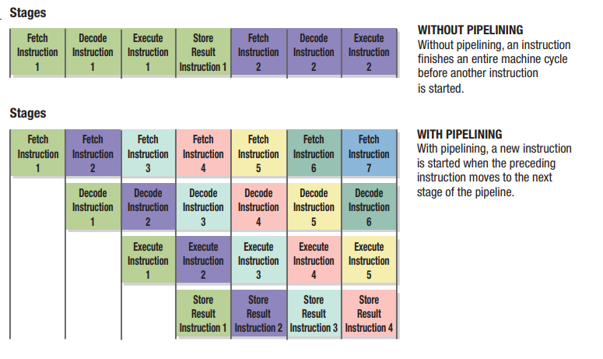
Making Computers Faster and Better Now and in the Future
Strategies for Making Faster and Better Computers
Pipelining
Capability of a CPU or CPU core to begin processing a new instruction as soon as the previous instruction completes the first stage of the machine cycle
Allows multiple instructions to be processed at one time

Slide 60
Making Computers Faster and Better Now and in the Future
Multiprocessing and Parallel Processing
Multiprocessing - Capability of a single computer to use multiple processors or multiple processing cores, usually to process multiple jobs at one time and to process those jobs faster than could be performed with a single processor
Parallel processing - Processing technique that uses multiple processors or multiple processing cores simultaneously, usually to process a single job as fast as possible
Use multiple processors to speed up processing

Slide 61
Making Computers Faster and Better Now and in the Future
Improved Architecture
Smaller components, faster bus speeds, multiple CPU cores, support for virtualization, creating CPUs with an increasing number of cores and integrated GPUs
Improved Materials
Flexible electronic components
– Copper, high-k, graphene chip

Slide 62
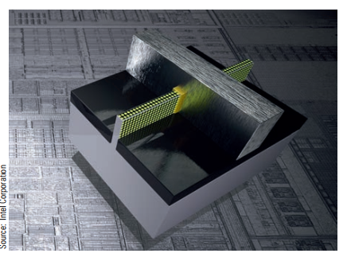
3D Chips
Three-dimensional (3D) chips are a technique for packing an increasing number of components onto small chips
Components are layered, which cuts down on surface area required
Especially important with notebook computers and mobile devices that have limited room inside the system unit

Slide 63
Summary
Data and Program Representation
Inside the System Unit
How the CPU Works
Making Computers Faster and Better Now and in the Future

